Slide 1
Golden gate bridge
The bridge above the Golden Gate

Slide 2
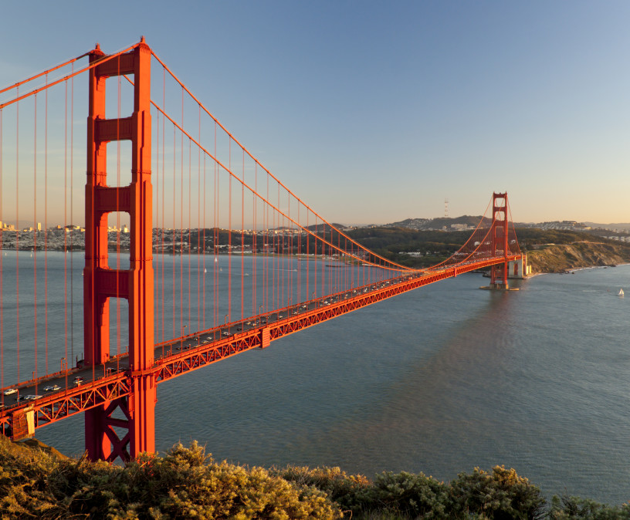
The golden gate
Carries 6 lanes of US 101 and SR 1
Pedestrian and bicycle way
Connect San Francisco to Marin County
Crosses the portion of SF bay called Golden Gate
California historical landmark

Slide 3
history
Before the bridge was built

Slide 4
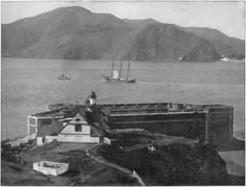
Crossing the gate
Boat service from Marin County to San Francisco
Service created for carrying water
Golden Gate Ferry Company
Notes:
Before the bridge was built, the only practical short route between San Francisco and what is now Marin County was by boat across a section of San Francisco Bay. A ferry service began as early as 1820, with a regularly scheduled service beginning in the 1840s for the purpose of transporting water to San Francisco.
The Sausalito Land and Ferry Company service, launched in 1867, eventually became the Golden Gate Ferry Company, a Southern Pacific Railroad subsidiary, the largest ferry operation in the world by the late 1920s.
Once for railroad passengers and customers only, Southern Pacific's automobile ferries became very profitable and important to the regional economy. The ferry crossing between the Hyde Street Pier in San Francisco and Sausalito in Marin County took approximately 20 minutes and cost $1.00 per vehicle.

Slide 5
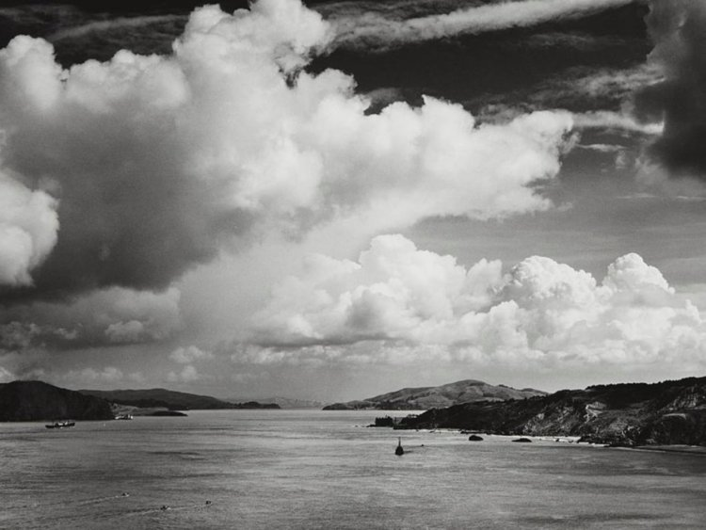
Bridge conception
San Francisco was the largest American city served by boat service
Unfriendly environmental conditions
The cost was estimated to $100 million
The design was finally proposed by Joseph Strauss
The project encountered oppositions
Notes:
Many wanted to build a bridge to connect San Francisco to Marin County. San Francisco was the largest American city still served primarily by ferry boats. Because it did not have a permanent link with communities around the bay, the city's growth rate was below the national average. Many experts said that a bridge could not be built across the 6,700-foot (2,000-metre) strait, which had strong, swirling tides and currents, with water 372 ft (113 m) deep at the center of the channel, and frequent strong winds. Experts said that ferocious winds and blinding fogs would prevent construction and operation.
Although the idea of a bridge spanning the Golden Gate was not new, the proposal that eventually took hold was made in a 1916 San Francisco Bulletin article by former engineering student James Wilkins.
San Francisco's City Engineer estimated the cost at $100 million (equivalent to $2.3 billion today), and impractical for the time. He asked bridge engineers whether it could be built for less. One who responded, Joseph Strauss, was an ambitious engineer and poet who had, for his graduate thesis, designed a 55-mile-long (89 km) railroad bridge across the Bering Strait. At the time, Strauss had completed some 400 drawbridges—most of which were inland—and nothing on the scale of the new project. Strauss's initial drawings were for a massive cantilever on each side of the strait, connected by a central suspension segment, which Strauss promised could be built for $17 million (equivalent to $391 million today).
Local authorities agreed to proceed only on the assurance that Strauss would alter the design and accept input from several consulting project experts. A suspension-bridge design was considered the most practical, because of recent advances in metallurgy.
Strauss spent more than a decade drumming up support in Northern California. The bridge faced opposition, including litigation, from many sources. The Department of War was concerned that the bridge would interfere with ship traffic. The navy feared that a ship collision or sabotage to the bridge could block the entrance to one of its main harbors. Unions demanded guarantees that local workers would be favored for construction jobs. Southern Pacific Railroad, one of the most powerful business interests in California, opposed the bridge as competition to its ferry fleet and filed a lawsuit against the project, leading to a mass boycott of the ferry service.

Slide 6
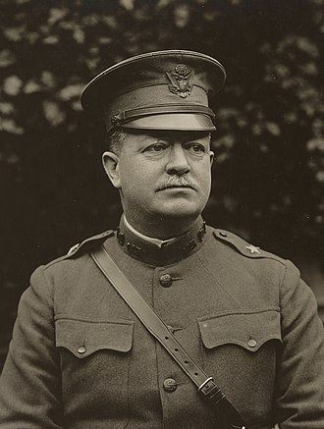
Project acceptance
Herbert Deakyne held the second hearing for the bridge
The project was finally approved
Approval was enhanced by car industry
Notes:
In May 1924, Colonel Herbert Deakyne held the second hearing on the Bridge on behalf of the Secretary of War in a request to use federal land for construction. Deakyne, on behalf of the Secretary of War, approved the transfer of land needed for the bridge structure and leading roads to the "Bridging the Golden Gate Association" and both San Francisco County and Marin County, pending further bridge plans by Strauss. Another ally was the fledgling automobile industry, which supported the development of roads and bridges to increase demand for automobiles.

Slide 7
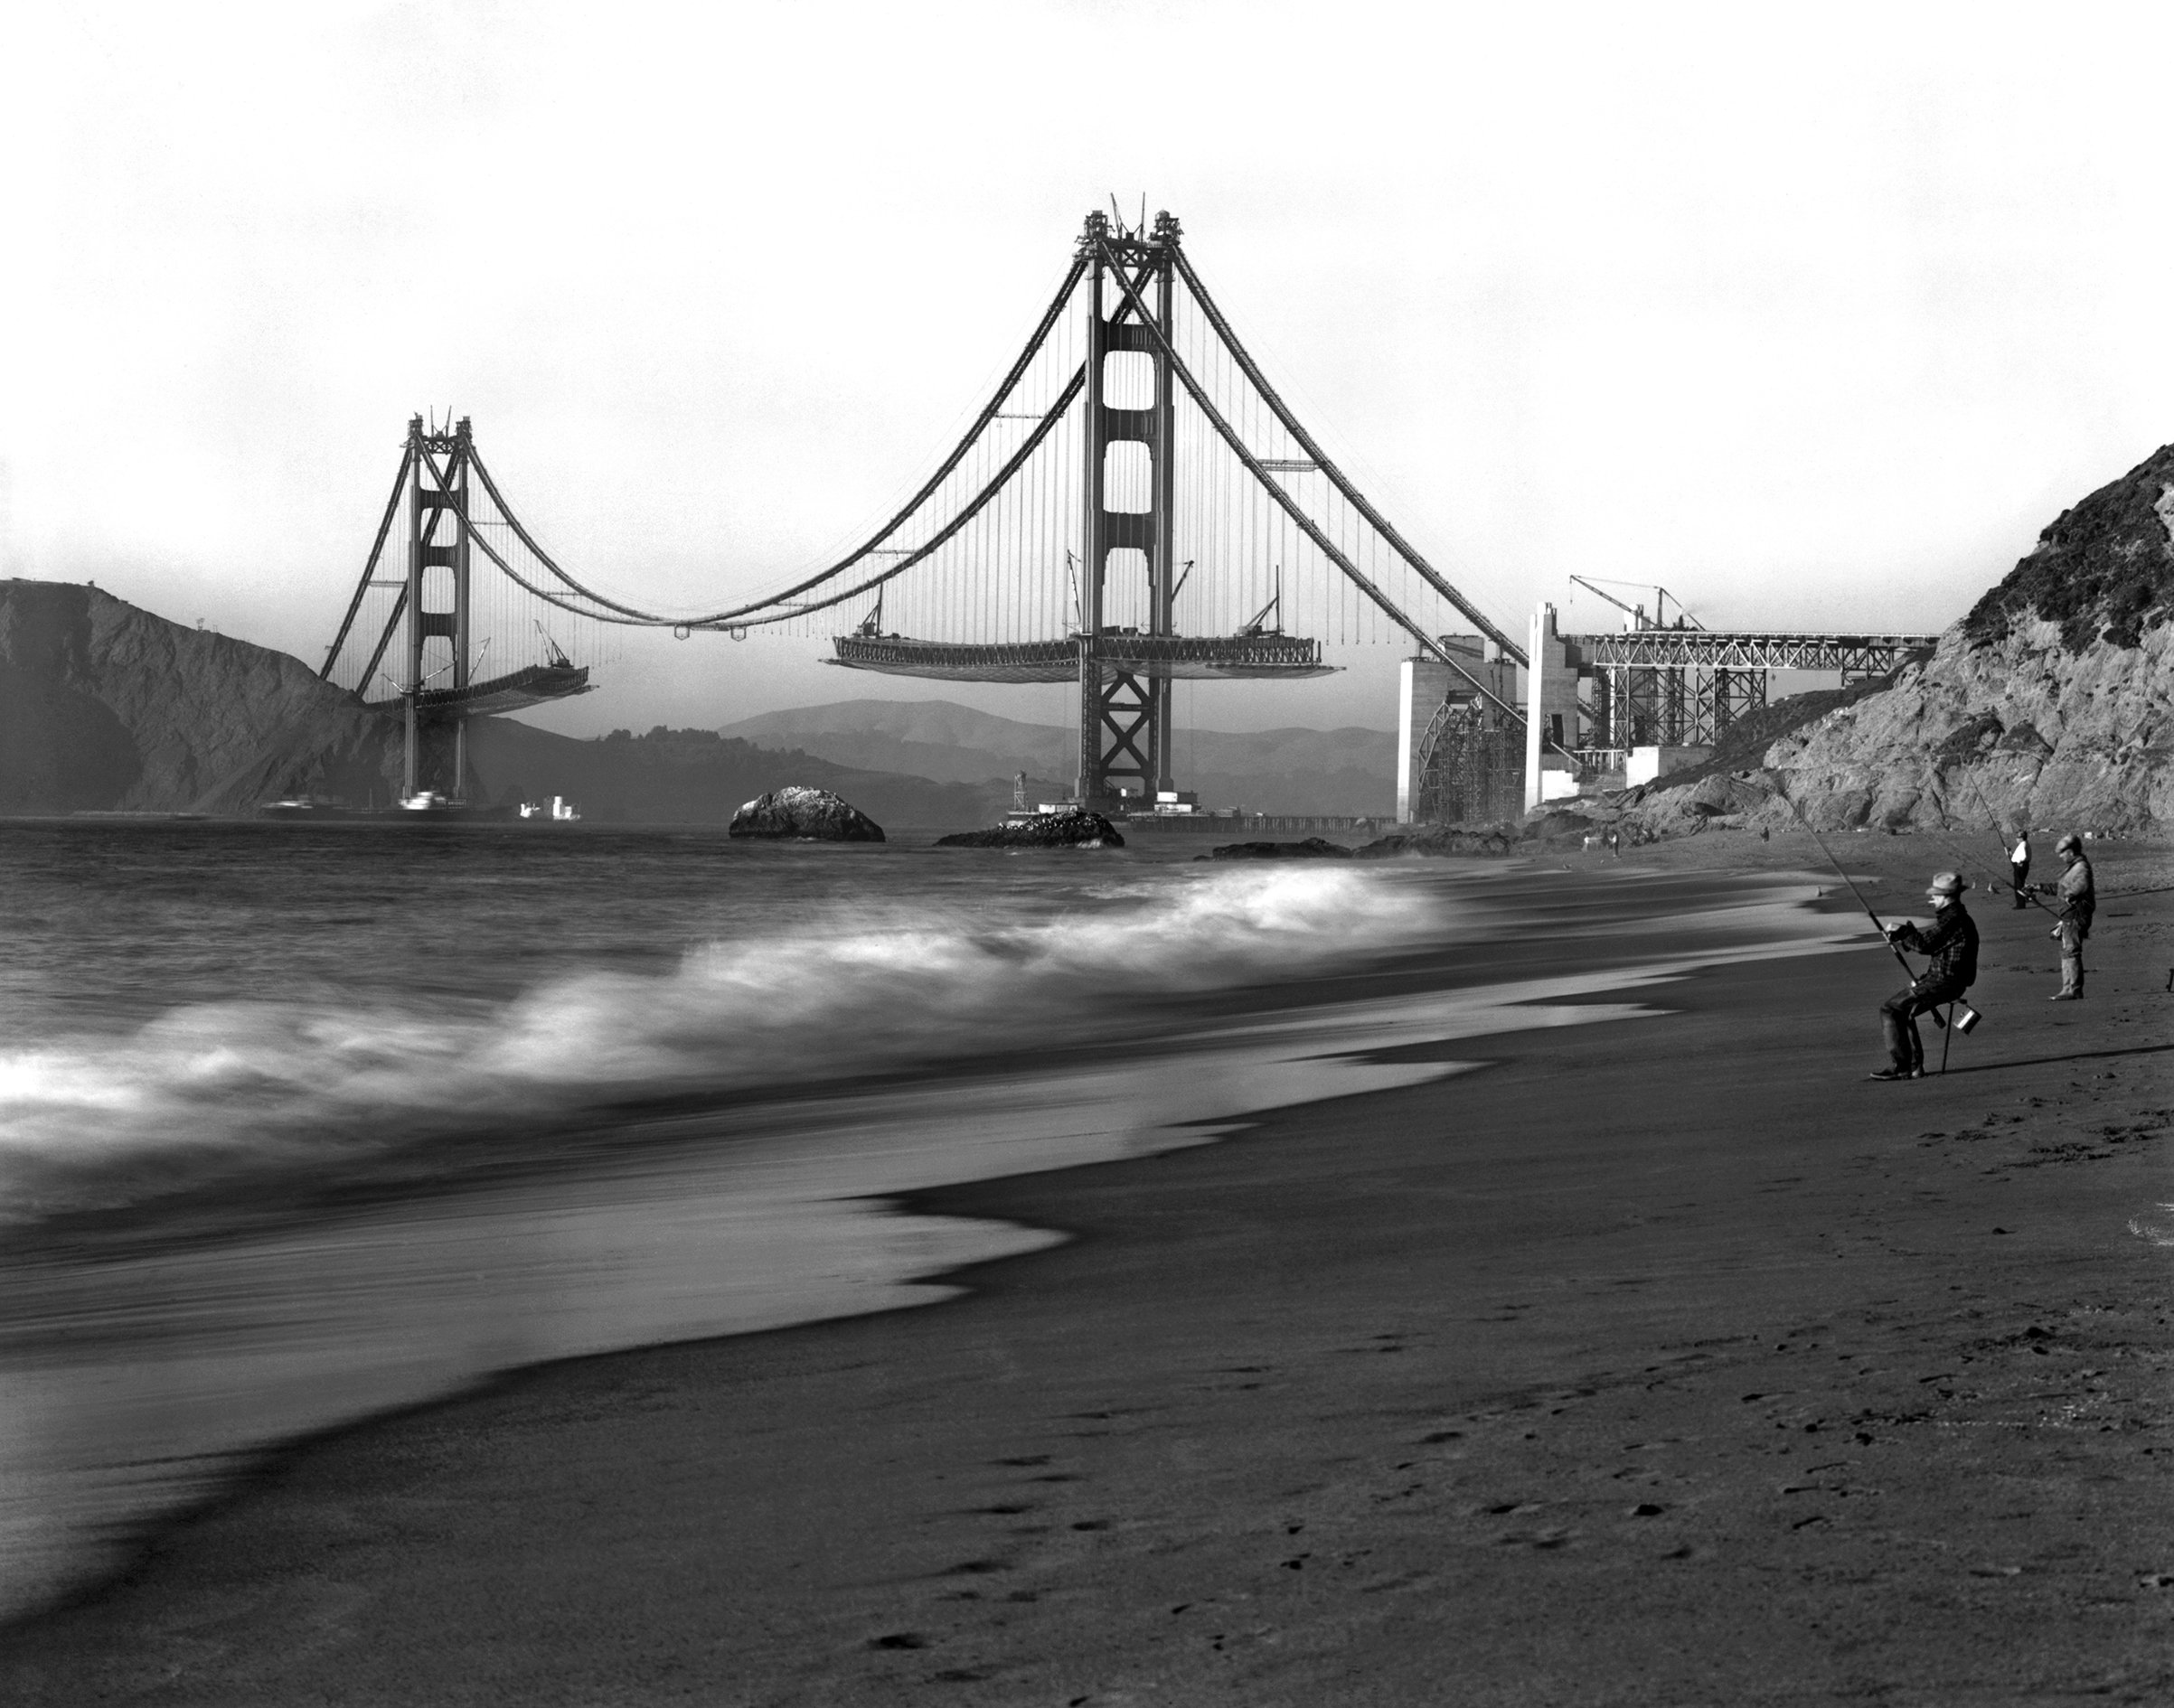
construction
Construction was begun on January 5, 1933
Strauss remained the head of the project
Eleven workers were killed during construction
The project was finished and opened May 27, 1937
Notes:
Construction began on January 5, 1933. The project cost more than $35 million, ($493 million in 2016 dollars) completing ahead of schedule and $1.3 million under budget (equivalent to $23.8 million today). The Golden Gate Bridge construction project was carried out by the McClintic-Marshall Construction Co., a subsidiary of Bethlehem Steel Corporation founded by Howard H. McClintic and Charles D. Marshall, both of Lehigh University.
Strauss remained head of the project, overseeing day-to-day construction and making some groundbreaking contributions. A graduate of the University of Cincinnati, he placed a brick from his alma mater's demolished McMicken Hall in the south anchorage before the concrete was poured. He innovated the use of movable safety netting beneath the construction site, which saved the lives of many otherwise-unprotected ironworkers. Of eleven men killed from falls during construction, ten were killed on February 17, 1937, when the bridge was near completion and the net failed under the stress of a scaffold that had fallen. The workers' platform that was attached to a rolling hanger on a track collapsed when the bolts that were connected to the track were too small and the amount of weight was too great to bear. The platform fell into the safety net, but was too heavy and the net gave way. Two out of the twelve workers survived the 200-foot (61 m) fall into the icy waters, including the 37-year-old foreman, Slim Lambert. Nineteen others who were saved by the net over the course of construction became members of their Half Way to Hell Club.
The project was finished and opened May 27, 1937.

Slide 8
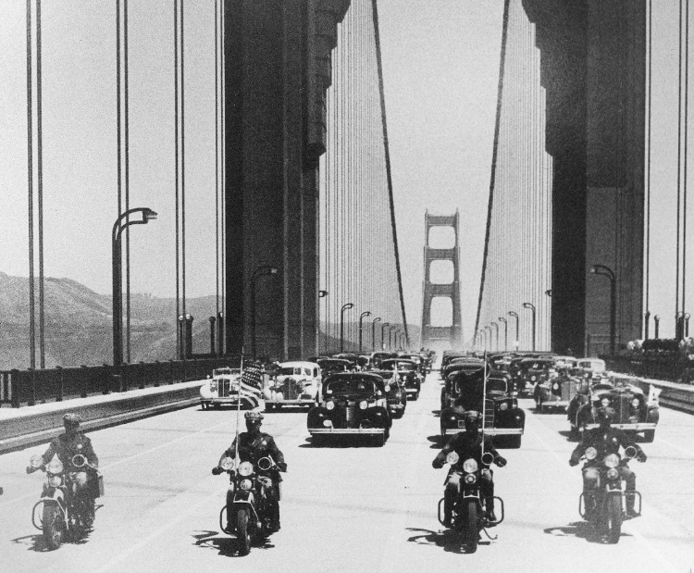
Bridge opening
May 27, 1937

Slide 9
The design
Two cantilevers and central suspension

Slide 10
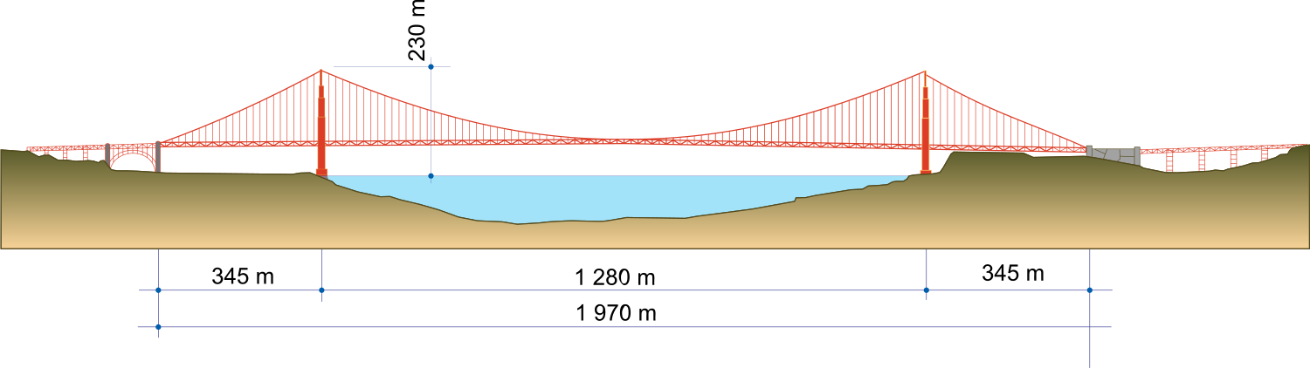
Basic structural design
Strauss’s design was unacceptable from a visual standpoint
The final idea was conceived and championed by Leon Moisseiff.
“Deflection theory” of the roadway
Notes:
Strauss was chief engineer in charge of overall design and construction of the bridge project. However, because he had little understanding or experience with cable-suspension designs, responsibility for much of the engineering and architecture fell on other experts. Strauss's initial design proposal (two double cantilever spans linked by a central suspension segment) was unacceptable from a visual standpoint. The final graceful suspension design was conceived and championed by Leon Moisseiff, the engineer of the Manhattan Bridge in New York City.

Slide 11
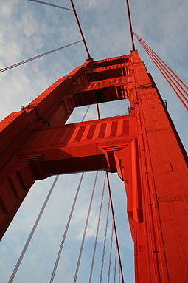
Bridge towers
Shape designed by Irving Morrow
Art Deco elements were inserted
The International Orange color was a sealant
The bridge should have been black and yellow, as the US Navy wanted
Notes:
Irving Morrow, a relatively unknown residential architect, designed the overall shape of the bridge towers, the lighting scheme, and Art Deco elements, such as the tower decorations, streetlights, railing, and walkways. The famous International Orange color was originally used as a sealant for the bridge. The US Navy had wanted it to be painted with black and yellow stripes to ensure visibility by passing ships.

Slide 12

The international orange color
The color was chosen to create contrast and blend well with the environment
The color had already been invented before the bridge construction
Many colors have been discussed
Morrow was finally convinced by an Italian American artist
Notes:
When the steel for the Golden Gate Bridge was fabricated by Bethlehem Steel at its foundries in PA and NJ, the steel was coated with a red lead primer. As the bridge towers began to rise for the Golden Gate Bridge, consulting architect Irving F. Morrow was commuting to the construction site from his home in the East Bay via ferry. He became inspired by the red lead color. Morrow undertook color studies, which resulted in the specification of the unique Golden Gate Bridge International Orange because it blended well with the nearby hills and contrasted with the ocean and sky.
Morrow recognized very clearly that the Bridge color was a very important influence on its appearance in relationship to its surroundings. As the Bridge stands today, the color blends perfectly with the changing season tints of the spans’ natural setting against the San Francisco skyline and the Marin hills. Morrow concluded, “The effect of International Orange is as highly pleasing as it is unusual in the realm of engineering.”
The final color was inspired by studies undertaken by Morrow in cooperation with other architects, engineers, painters, sculptors, and others. Morrow also included black, grey, and aluminum in the studies, ruling each out for a range of reasons. Black would be unattractive and would reduce the scale of the bridge more than any other color. Proponents for the aluminum color reported that this color would give beauty as the beauty of a dirigible aircraft. Morrow rejected it as the towers would be deprived of substance and made tiny. Battleship grey and warm grey were studied. Warm grey was named as the distant second to orange vermillion.

Slide 13
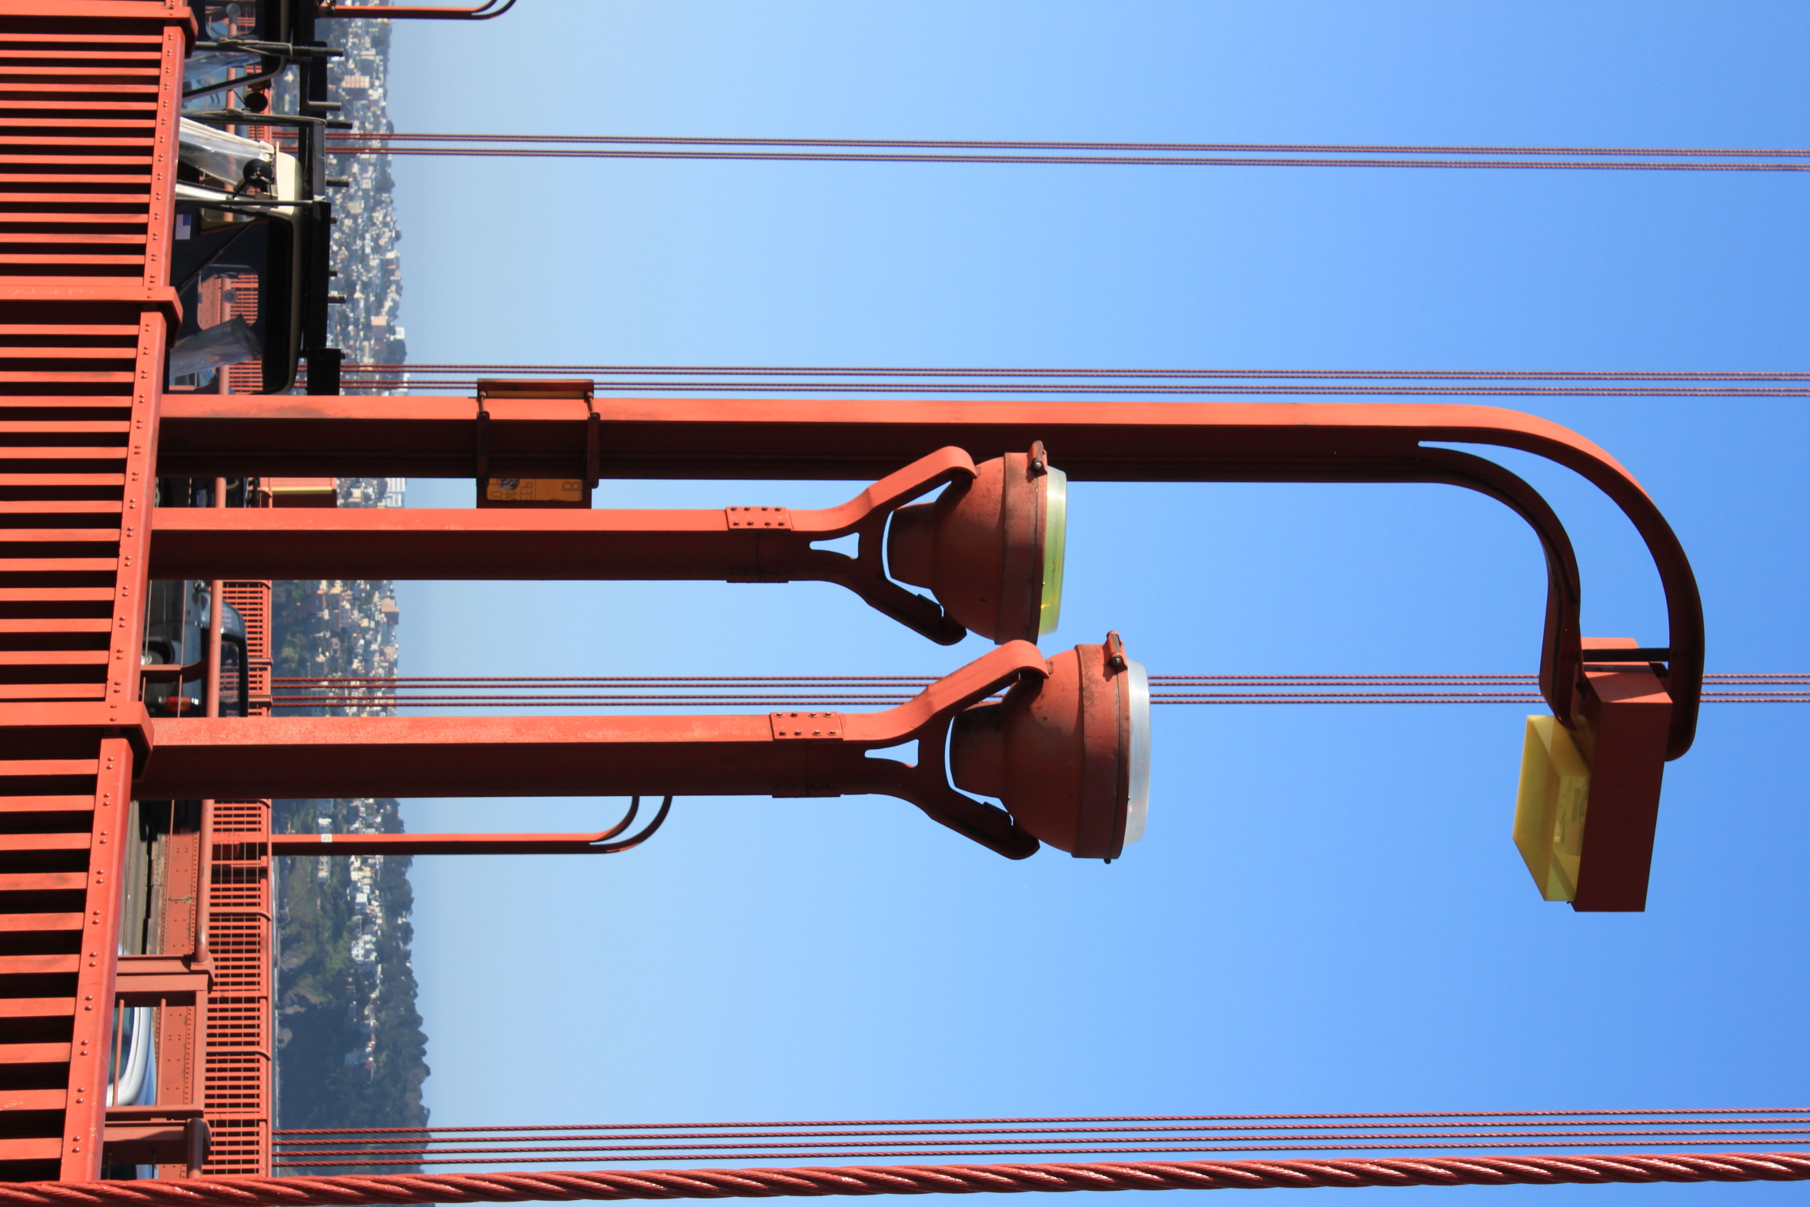
Art Deco Design Theme
The original theme was regarded as unsightly
The Art Deco themes have been introduced by architect Morrow
Pedestrian railings simplified
Vertical ribbing added on the horizontal tower bracing
Decreasing rectangular portals
Notes:
The original plans submitted by Chief Engineer, Joseph B. Strauss, called for a hybrid cantilever and suspension structure across the Golden Gate. This plan was generally regarded as unsightly, and a far cry from the elegant, understated lines that define the Bridge today. After Strauss submitted his first design, Consulting Engineer, Leon S. Moisseiff, theorized that a long span suspension bridge could cross the Gate. A suspension structure of this length had never been tried before.
Even after Moisseiff and Strauss began to refine the new design, it wasn't until Consulting Architect Irving F. Morrow joined the project that the art deco styling began to take shape. Morrow simplified the pedestrian railings to modest, uniform posts placed far enough apart to allow motorists an unobstructed view. The light posts took on a lean, angled form. Wide, vertical ribbing was added on the horizontal tower bracing to accent the sun's light on the structure. The rectangular tower portals themselves decrease on ascent, further emphasizing the tower height. These architectural enhancements define the Golden Gate Bridge's art deco form. It is this form which is known and admired the world over.

Slide 14
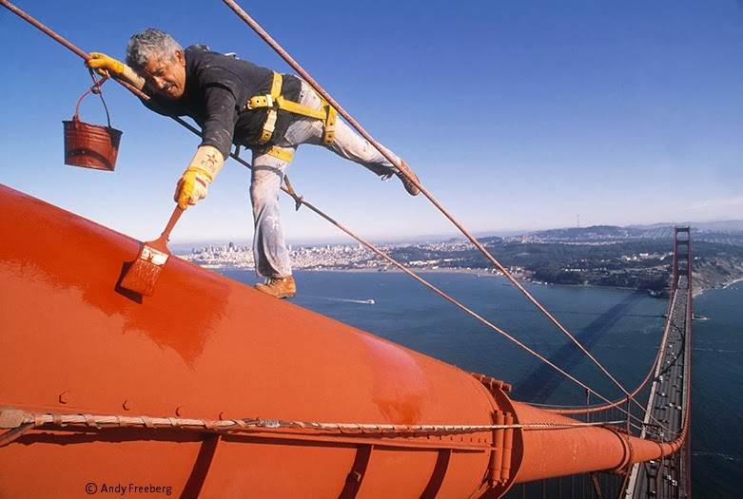
Painting the bridge
The bridge is continuously painted
The original lead based paint have been replaced by 1968
The corrosion is kept under control
Notes:
There are a couple of misconceptions about how often the Bridge is painted. Some say once every seven years, others say from end to end each year. The truth is that the Bridge is painted continuously. Painting the Bridge is an ongoing task and a primary maintenance job. The paint applied to the Bridge’s steel protects it from the high salt content in the air which can cause the steel to corrode or rust.
By 1968, advancing corrosion sparked a program to remove the original lead based paint (primer and topcoat) and replace it with an inorganic zinc silicate primer and vinyl topcoats. This process was completed in 1995. Note that in 1990, the topcoat was changed from a vinyl to an acrylic emulsion to meet air quality (Volatile Organic Compounds or VOC) requirements.

Slide 15
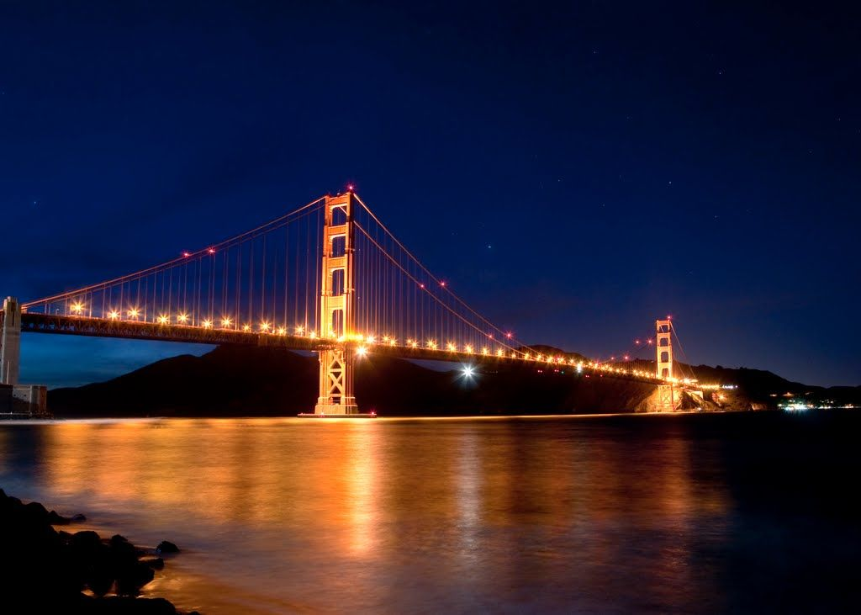
Bridge lighting
The bridge is made unique by this
The lighting was meant to enhance the bridge dignity
In 1972 the roadway lamps were replaced
Towers lighting have been chosen to make them appear taller than they are
Notes:
the enormous size of the project; and, 2) the tremendous scale and dignity of the project. Morrow carefully weighed these considerations as he designed his lighting scheme, one which would even further accent the uniqueness of the Golden Gate Bridge.
Because of the Bridge's great size, Morrow did not want the same intensity of light on all of its parts. The effect would seem too artificial. The towers, for example, were to have less light at the top, so they would seem to soar beyond the range of illumination. Further, because of the scale and dignity of the Bridge, Morrow believed tricky, flashy or spectacular lighting would be unworthy of the structure's magnificence. Thus, he selected low pressure sodium vapor lamps with a subtle amber glow for the roadway, providing warm, non-glare lighting for passing motorists. The lamps were the most modern available in 1937.
Forty-five years later in 1972, the original low pressure sodium roadway lights were replaced with high-pressure sodium vapor lamps. These modern lamps provide improved lighting at a lower cost. To preserve the original warm glow, the new lamp heads have a plastic amber lens.
Just as Morrow had envisioned, the new lighting made the towers seem to disappear into the evening darkness, further accenting their great height.

Slide 16
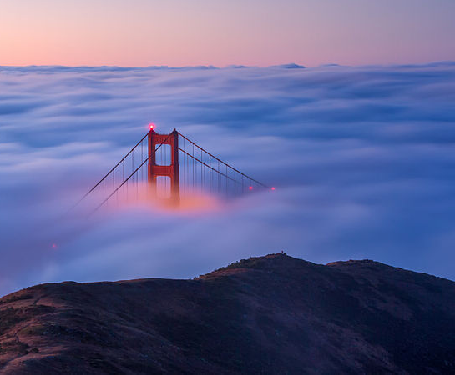
The bridge and the fog
This is a typical sight of the Golden Gate Bridge in the morning

Slide 17
sources
https://en.wikipedia.org/wiki/Golden_Gate_Bridge
http://goldengatebridge.org/
https://www.sftravel.com/golden-gate-bridge

